Slide 1


Nevada Department of Corrections
Proposed FY24-25 CIP to State Public Works Board

Slide 2
Presenters:
Charles Daniels – Director
William Gittere - Deputy Director
Ralph Wagner - Chief Engineer

Slide 3
Department Overview
The DOC has proposed 168 CIPs (85 presented herein) and 37 SWPs (not presented) for FY24-25 to continue its mission at 18 facilities.

Slide 4
NDOC’s Statements
Mission
The Nevada Department of Corrections will improve public safety by ensuring a safe and humane environment that incorporates proven rehabilitation initiatives that prepare individuals for successful reintegration into our communities.
Vision
Reduce victimization and recidivism by providing offenders with incentive for self-improvement and the tools to effect change.
Notes:
In support of the requested CIP’s I would like to take the opportunity to discuss the importance of “Overwatch” as it relates to the need for updates to our technology. “Overwatch is a corrections command and control platform utilizing technology as a force multiplier to mitigate staff shortages, inadequate technology, antiquated communications systems and inadequate staff professional development.” Essentially, we can forecast offender population growth; however, staffing is not projected to increase as rapidly. Therefore, it is imperative for us to illustrate the need for consideration and approval of the items listed. Thank you.

Slide 5
Contents
  NDOC’s Population Projections
  Master Plan Overview
  Proposed CIPs
    Abbreviations
    Vetting
    Philosophy
    1 thru 40
    41 thru 85
    86 thru 168 (not included)

Slide 6
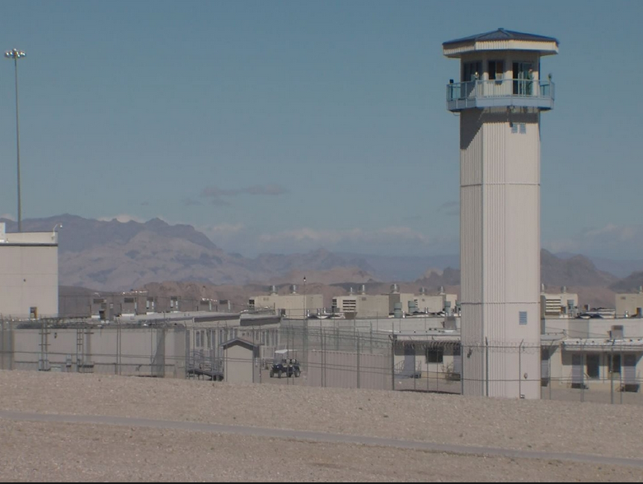
NDOC’s Population Projections

Slide 7
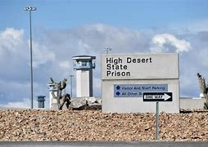
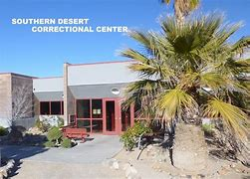
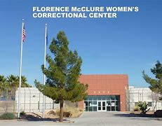
NDOC’s Population Projections

Slide 8
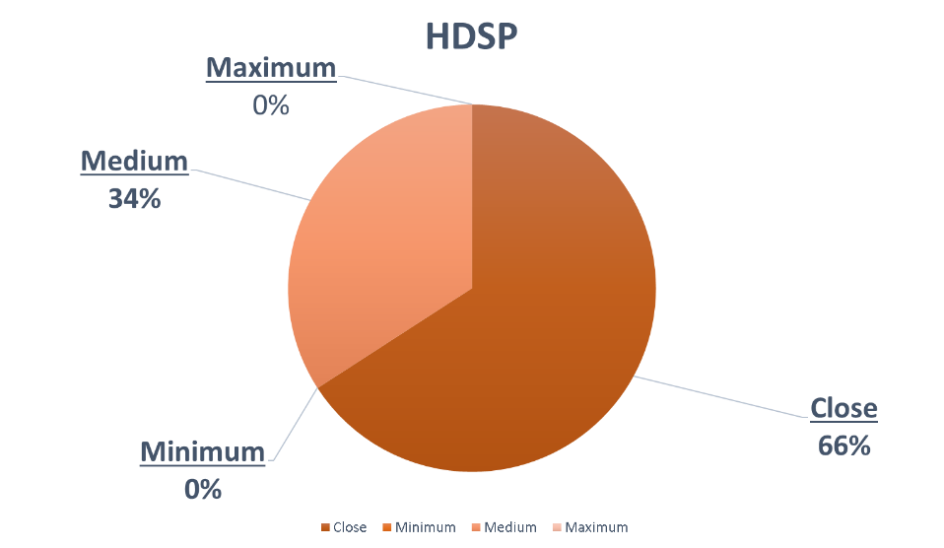
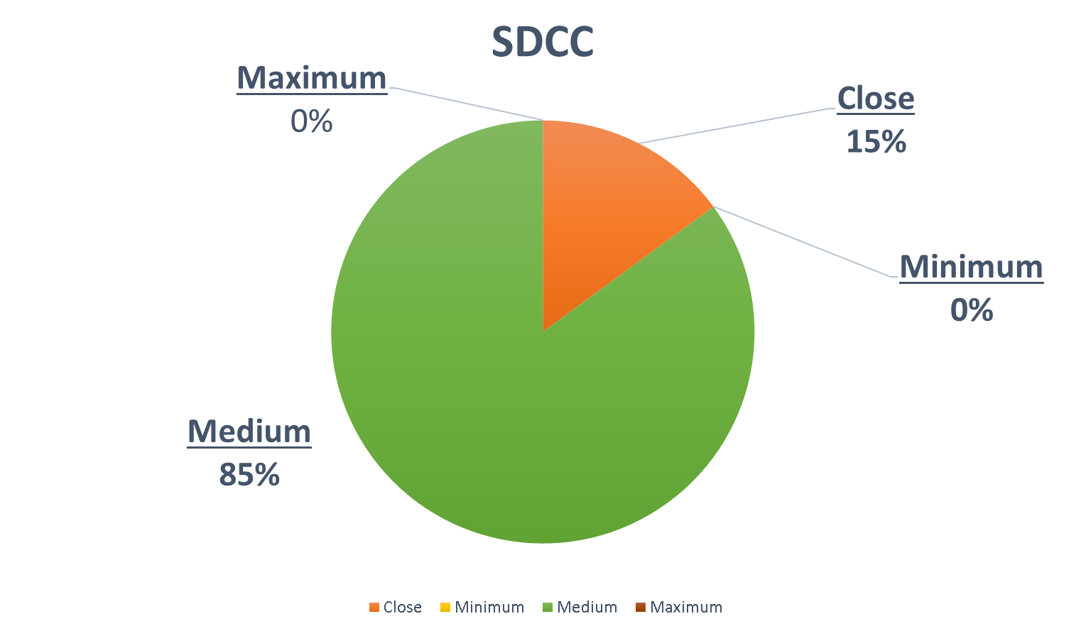
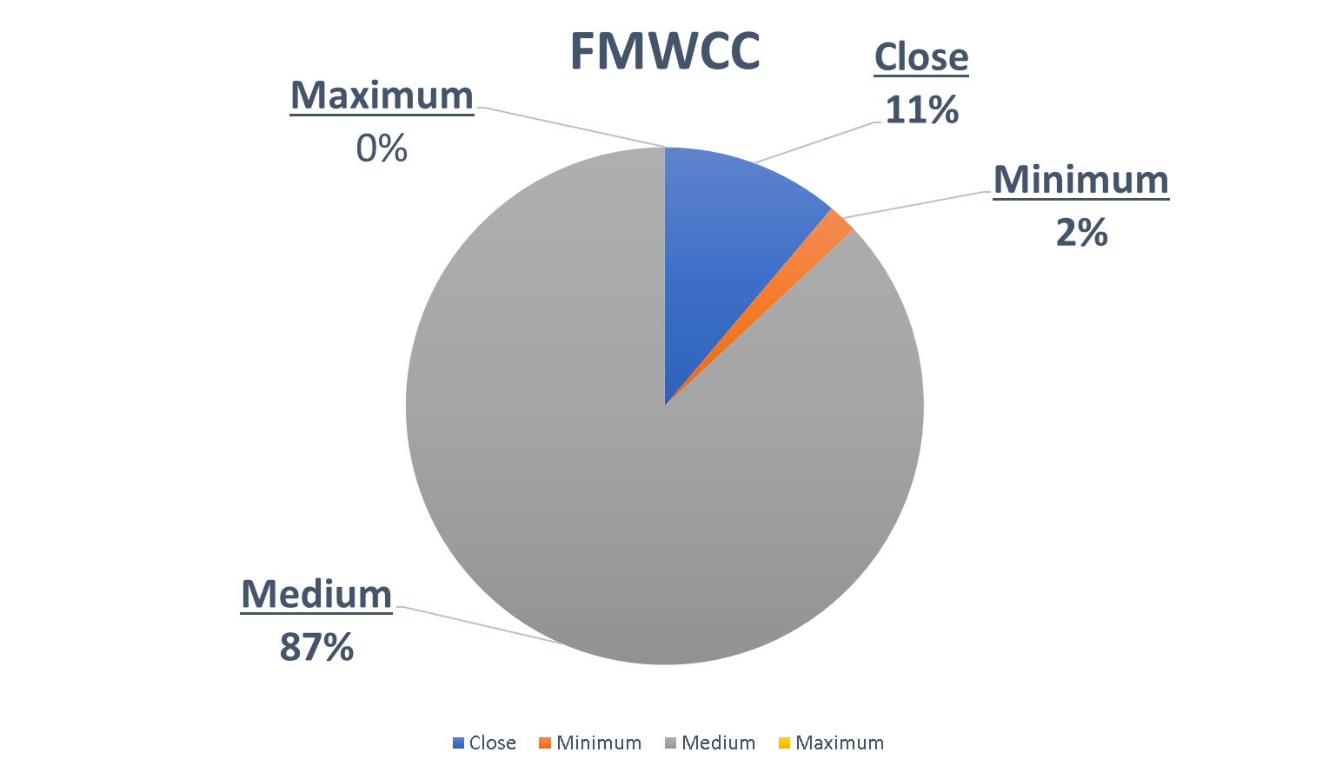
Custody Bed Capacity
(Total = 10,318 as of August 7, 2022 )

Slide 9
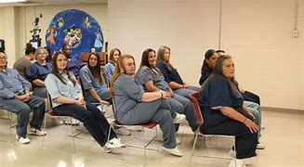
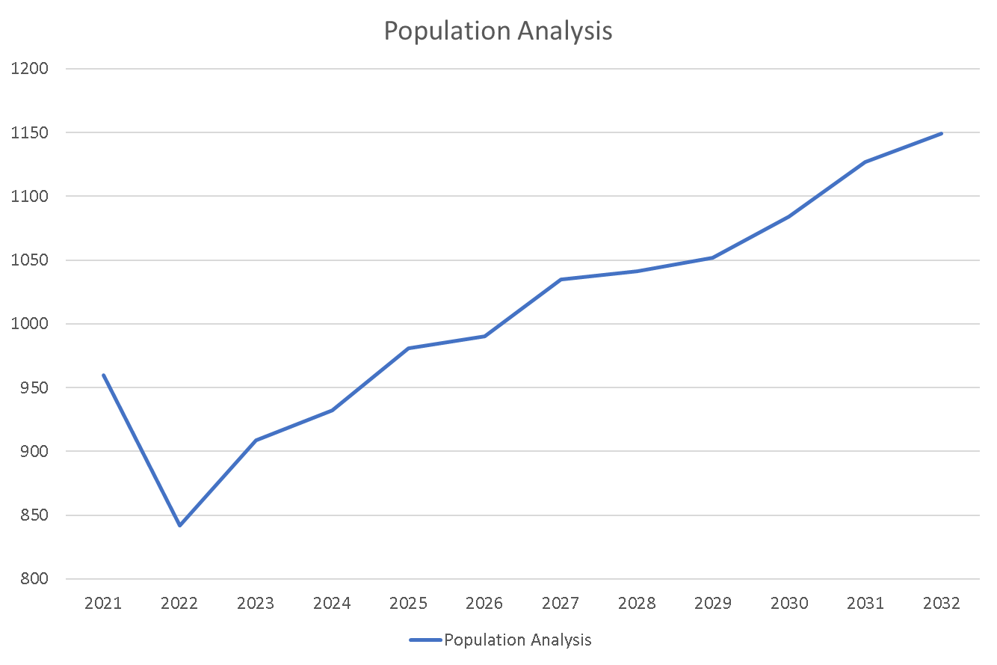
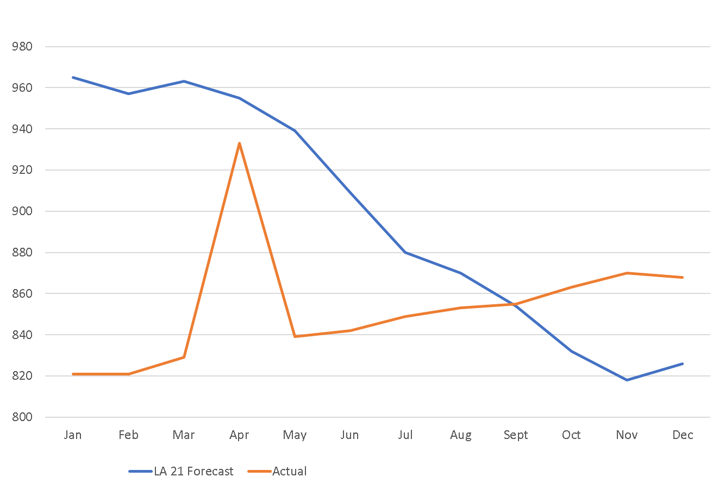
Female Population
CY2022: Legislature Approved Forecast and Actual
The population analysis is projected to increase over the next 10 years. Due to limited staff in the north, a high demand for additional staff and space is vital to cover the higher occupancy in the south.

Slide 10
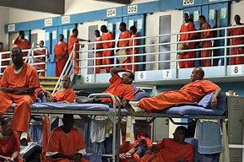
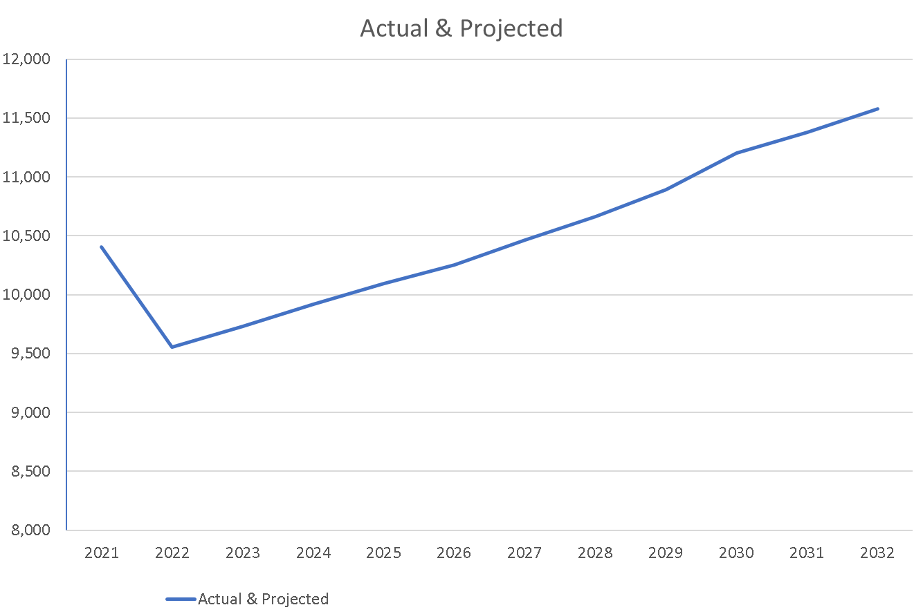
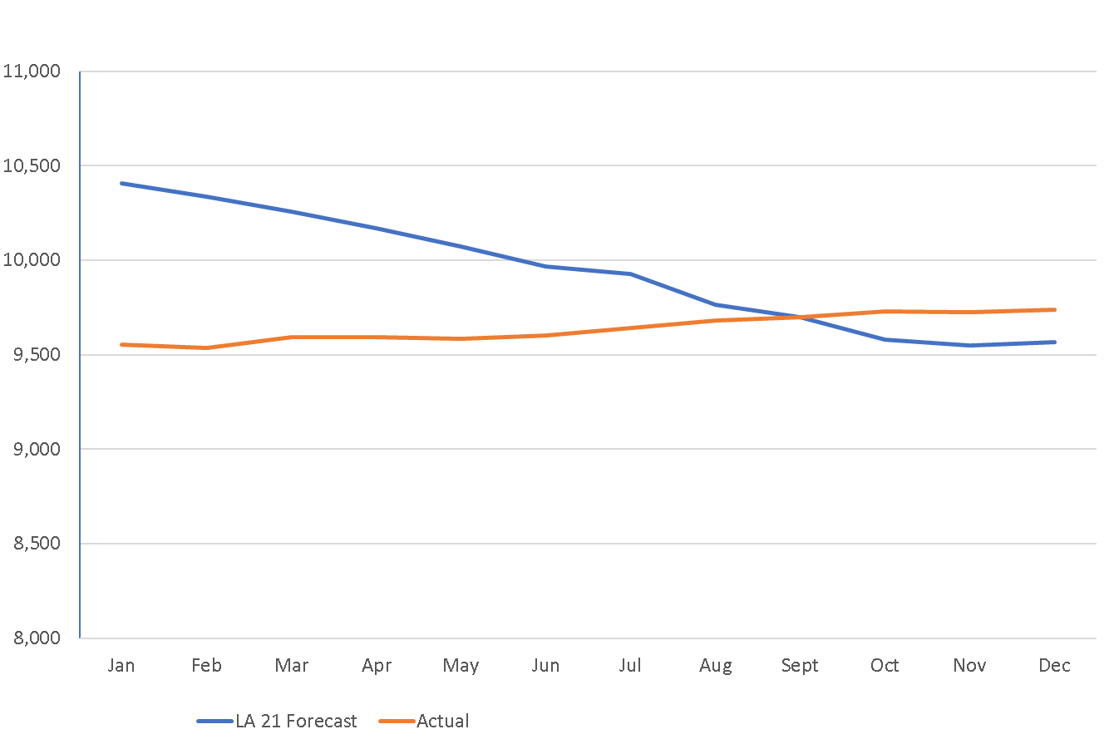
Male Population
With the male population already reaching capacity, the projection predicts that the numbers will steadily increase. At this rapid rate, we are overwhelming the current staff versus male population. All institutions in the South are absorbing numerous offenders from the North due to minimal staffing, however, each Southern facility is reaching their max.

Slide 11

Master Plan Overview

Slide 12
Master Plan Overview (continued)
Intended to Remedy Capacity Needs
Capacity Projections by JFA Institute
Six Major Building Projects Proposed:
  FMWCC - Housing Unit, Warehouse, Program Space, and Expanded Perimeter Fence
  SDCC - Two Housing Units
  NNCC - Two Dormitories, Housing Unit, Kitchen, Dining, Laundry, Central Plant, Warehouse, Armory, and Medical
  Prison 8 – Full Build Out, Six Housing Units, Ancillary Facilities
  TLVCC – Dormitory, Housing Unit, Support Bldg.
  SCC – Dormitory, Support Building

Slide 13
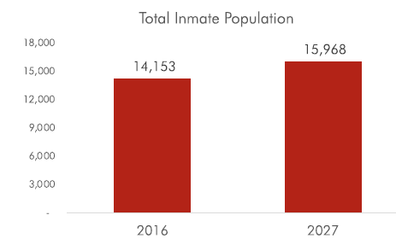
Master Plan Bases (1 of 3)

Slide 14
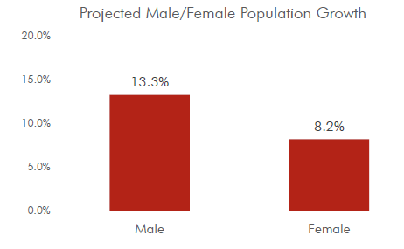
Master Plan Bases (2 of 3)

Slide 15
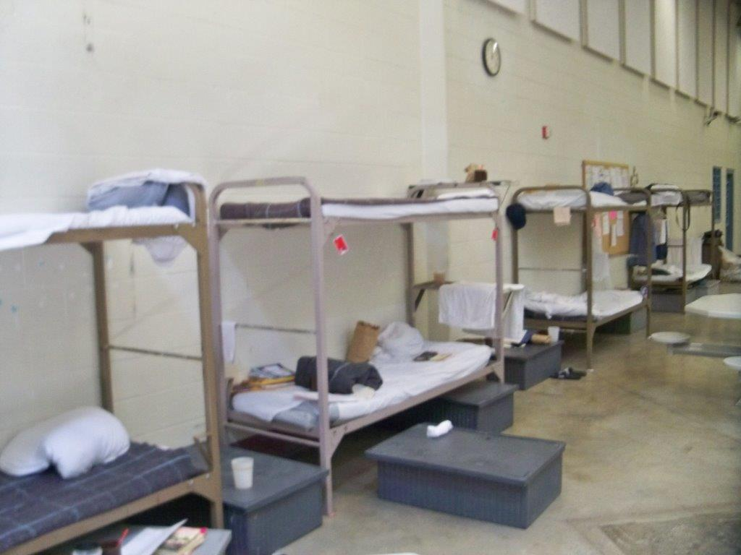
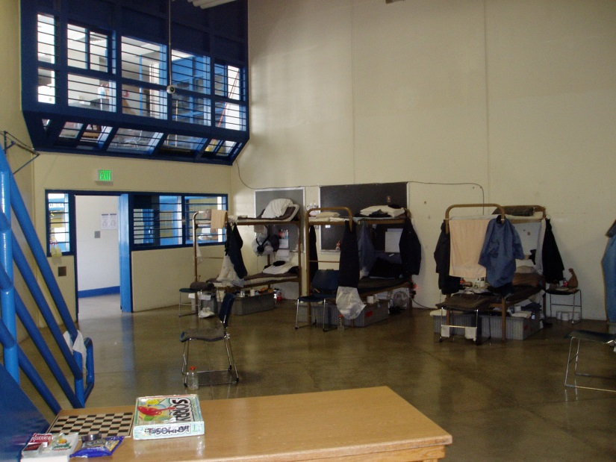
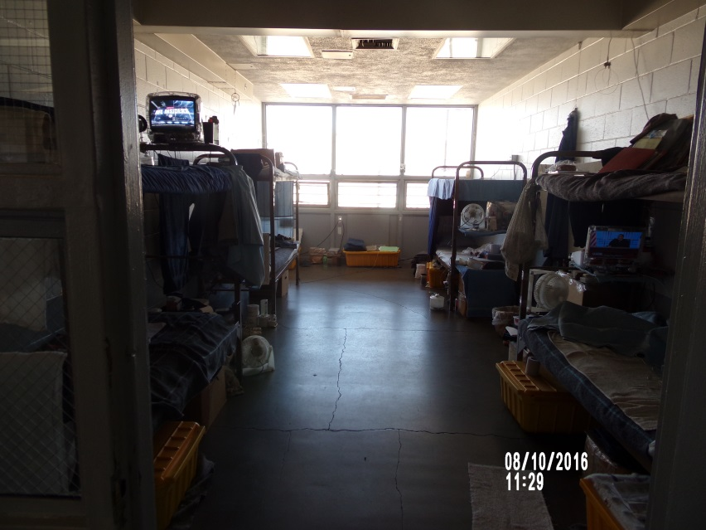
Master Plan Bases – Overcrowding (3 of 3)
NNCC
FMWCC
LCC

Slide 16
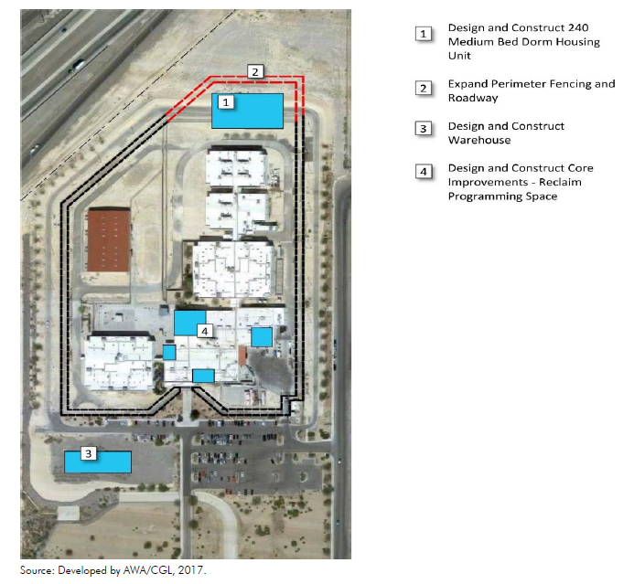
Master Plan – FMWCC

Slide 17
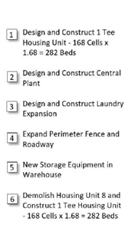
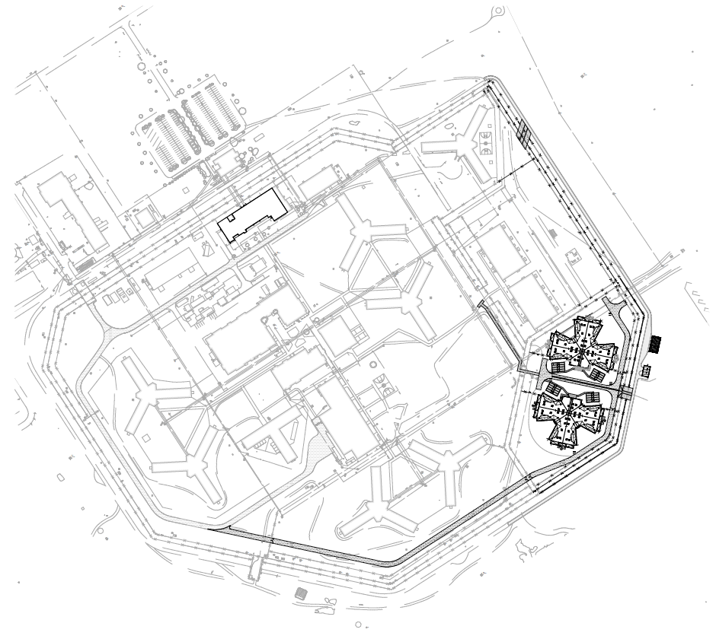
Master Plan – SDCC

Slide 18
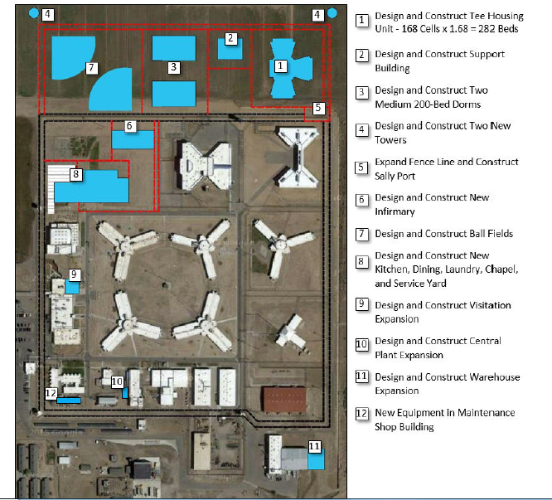
Master Plan – NNCC

Slide 19
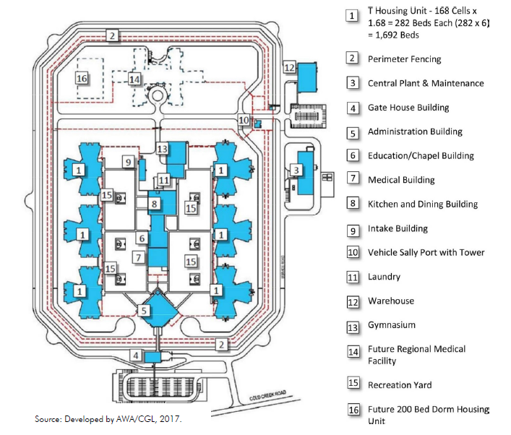
Master Plan – Prison 8

Slide 20
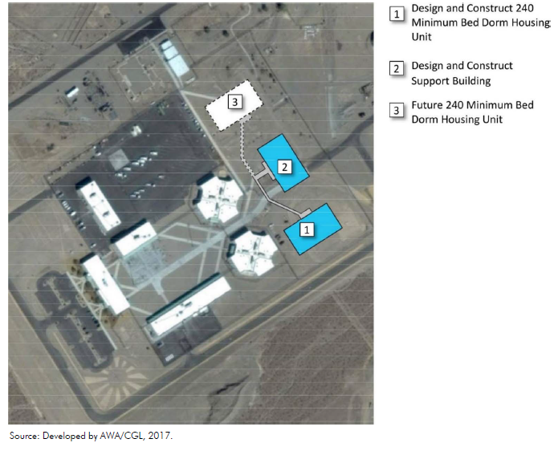
Master Plan – TLVCC

Slide 21
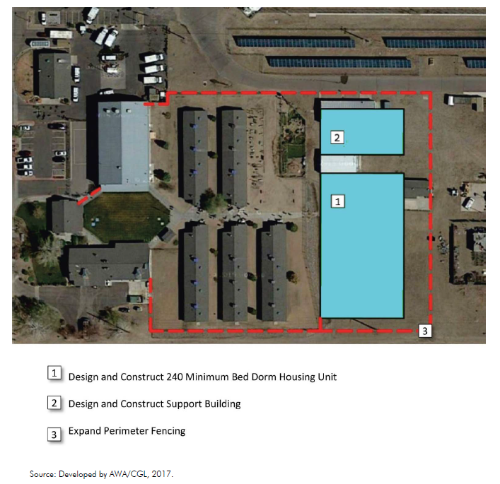
Master Plan – SCC

Slide 22
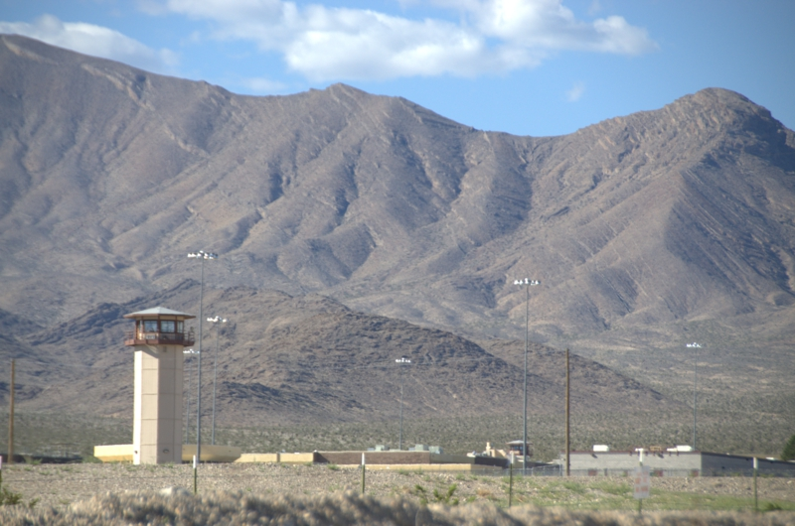
Proposed CIPs

Slide 23
Facility Abbreviations (1 of 2)
CCC – Carlin Conservation Camp
CGTH – Casa Grande Transitional Housing
ECC – Ely Conservation Camp
ESP – Ely State Prison
FMWCC – Florence McClure Women’s Corr. Center
HCC – Humboldt Conservation Camp
HDSP – High Desert State Prison
JCC – Jean Conservation Camp
LCC – Lovelock Conservation Camp
NNCC – Northern Nevada Correctional Center

Slide 24
Facility Abbreviations (2 of 2)
NNTH – Northern Nevada Transitional Center
NSP – Nevada Sate Prison (Closed)
PCC – Pioche Conservation Camp
SCC – Stewart Conservation Camp
SDCC – Southern Desert Correctional Center
SNCC – South. Nevada Correctional Center (Closed)
SSCC – Silver Springs Correctional Center (Closed)
TCC – Tonopah
Conservation Camp
TLVCC – Three Lakes Valley Conservation Camp
WCC – Wells Conservation Camp
WSCC – Warm Springs Correctional Center

Slide 25
Personnel Abbreviations
D – Director
DD – Deputy Director
AD – Asst. to Director
W – Warden
AW – Associate Warden
Lt – Lieutenant
CE – Chief Engineer
FM – Facility Manager
FS – Facility Supervisor
ASO – Administrative Services Officer
NDOC – Nevada Department of Corrections
SPWD – State Public Works Department

Slide 26
CIP Vetting Process
W, AW, Lt, ASO, FS – Develop and Rank New CIPs for each of the 18 Facilities
CE – Merge New CIPs with Old (Non-Funded FY18-19) CIPs
CE - Rank All CIPs (1 thru 176)
D and DDs – Review and Edit Ranking of All CIPs
CE – Submit 168 CIPs with Final Rankings to SPWD
SPWD – Review, Evaluate, Consolidate (as needed), and Estimate Cost of All CIPs
CE and DDs - Review and Edit SPWD Updated CIPs
SPWD – Address NDOC’s Updated CIPs and Publish Final Set of CIPs

Slide 27
CIP Philosophy
The primary focus of the proposed CIPs is on recent NDOC’s Re-Imagined philosophy that includes implementing more technology (i.e., surveillance systems) to offset difficulty in recruiting and maintaining staff while improving our overall performance.
This philosophy continues to be driven by consideration of safety and security of our staff and offenders.
Consequently, the initial 40 proposed CIPs (of our proposed 168 CIPs) are highlighted and intended to reflect this recent paradigm shift in NDOC’s philosophy.

Slide 28
CIPs: 1 - 5
Facility and Description | ID No. | Cost Range ($Million) | Ranking (A B C) |  |  |  | NDOC Priority
 |  |  | Safety | Security | Infra-Structure | Energy
SDCC – Replace Doors, Locks, and Security Glazing | 7290 | 20-25 | A | A | A | B | 1
HDSP – Install Security Cameras | 7198 | 0.1-5 | A | A | B | B | 2
ESP– Install Site Security Cameras | 21070 | 0.1-5 | A | A | A | B | 3
SDCC – Install Surveillance Cameras | 7161 | 5-10 | A | A | A | B | 4
NNCC – Replace Surveillance Camera System | 23106 | 0.1-5 | A | A | A | B | 5

Slide 29
CIPs: 6 - 10
Facility and Description | ID No. | Cost Range ($Million) | Ranking (A B C) |  |  |  | NDOC Priority
 |  |  | Safety | Security | Infra-Structure | Energy
LCC – Replace Surveillance Camera System | 7083 | 5-10 | A | A | A | B | 6
SDCC – Install Fiber Optic Loop | 23105 | 0.1-5 | A | A | A | B | 7
SDCC – Expand Communication Room | 21073 | 0.1-5 | A | A | A | B | 8
WSCC – Install Surveillance Camera System | 7141 | 0.1-5 | A | A | A | B | 9
ESP – Replace Doors, Locks, and Controls in Housing Units 1 and 2 | 19341 | 5-10 | A | A | A | B | 10

Slide 30
CIPs: 11 - 15
Facility and Description | ID No. | Cost Range ($Million) | Ranking (A B C) |  |  |  | NDOC Priority
 |  |  | Safety | Security | Infra-Structure | Energy
HDSP - Replace Doors, Locks, and Controls | 23098 | 15-20 | A | A | A | B | 11
FMWCC – Replace Door Controls and Intercoms in Buildings 7, 8, 10, and 11 | 23100 | 0.1-5 | A | A | A | C | 12
WSCC – Replace Doors, Locks, and Controls | 19288 | 5-10 | A | A | A | C | 13
CGTH – Replace Door Access System | 23097 | 0.1-5 | A | A | A | C | 14
LCC – Renovate Cell Door System | 23107 | 15-20 | A | A | A | C | 15

Slide 31
CIPs: 16 - 20
Facility and Description | ID No. | Cost Range ($Million) | Ranking (A B C) |  |  |  | NDOC Priority
 |  |  | Safety | Security | Infra-Structure | Energy
SDCC – Renovate Firing Range | 19325 | 0.1-5 | A | A | B | C | 16
FMWCC – Replace HVAC Systems | 21084 | 5-10 | A | A | A | A | 17
HDSP – Advance Planning: Underground Piping Replacement | 23110 | 0.1-5 | A | A | A | A | 18
HDSP – Advance Planning: Mechanical Equipment Replacement | 23111 | 0.1-5 | A | A | A | A | 19
ESP - Upgrade Recreational Yards | 23102 | 0.1-5 | A | A | B | B | 20

Slide 32
CIPs: 21 - 25
Facility and Description | ID No. | Cost Range ($Million) | Ranking (A B C) |  |  |  | NDOC Priority
 |  |  | Safety | Security | Infra-Structure | Energy
LCC – Upgrade Recreational Enclosures | 23108 | 0.1-5 | A | A | A | C | 21
SDCC – Replace Armory | 7463 | 0.1-5 | A | A | A | C | 22
HDSP – Install Shower Enclosures in Housing Units 9, 10, 11, and 12 | 23120 | 5-10 | A | A | A | C | 23
LCC – Renovate Firing Range | 19337 | 0.1-5 | A | A | B | C | 24
NNCC – Install Recreational Enclosures | 23101 | 0.1-5 | A | A | A | C | 25

Slide 33
CIPs: 26 - 30
Facility and Description | ID No. | Cost Range ($Million) | Ranking (A B C) |  |  |  | NDOC Priority
 |  |  | Safety | Security | Infra-Structure | Energy
WSCC – Install Recreational Enclosures | 23109 | 5-10 | A | A | A | C | 26
NNCC – Renovate RMF Boiler Plant | 23113 | 0.1-5 | B | B | A | A | 27
LCC – Renovate Chiller and Hot Water Components in Several Buildings | 23114 | 0.1-5 | B | B | A | A | 28
WSCC – Renovate HVAC Systems | 19340 | 0.1-5 | B | B | A | A | 29
NNCC – Renovate Recreational Yards | 21071 | 0.1-5 | A | A | A | C | 30

Slide 34
CIPs: 31 - 35
Facility and Description | ID No. | Cost Range ($Million) | Ranking (A B C) |  |  |  | NDOC Priority
 |  |  | Safety | Security | Infra-Structure | Energy
SDCC – Renovate Domestic Hot Water Systems | 21069 | 5-10 | B | B | A | A | 31
ESP – Replace Culinary Plumbing | 21058 | 0.1-5 | B | B | A | A | 32
LCC – Replace Culinary Floor | 7114 | 0.1-5 | A | B | A | B | 33
FMWCC – Replace Water Controls in Housing Units | 23309 | 0.1-5 | C | C | A | A | 34
CGTH – Replace Water Heaters | 23115 | 0.1-5 | C | C | A | A | 35

Slide 35
CIPs: 36 - 40
Facility and Description | ID No. | Cost Range ($Million) | Ranking (A B C) |  |  |  | NDOC Priority
 |  |  | Safety | Security | Infra-Structure | Energy
ESP – Renovate Firing Range | 19319 | 0.1-5 | A | A | A | C | 36
SDCC – Upgrade Electrical Service | 21074 | 0.1-5 | A | A | A | B | 37
NNCC – Advance Planning: Culinary and Bakery Buildings | 23116 | 0.1-5 | B | B | A | A | 38
SDCC – Replace Cell Toilets in Housing Units 1-7 | 7465 | 15-20 | A | A | A | C | 39
LCC – Improve Wastewater System | 23119 | 5-10 | B | B | A | B | 40

Slide 36
Remaining CIPs (41-86)
Note: CIPs 87-168 Not Shown

Slide 37

CIPs: 41-50
(Note: Costs are Approx.)
41. ESP – Upgrade Exterior Lighting (21072) - $1.4M
42. HDSP – Replace Steam and Refrig. Comp. (23121) - $2.8M
SDCC – Construct Two Housing Units (19343) - $152M
NNCC – Adv. Plan: HU and Core Expansion (19344) - $6.7M
ESP – Upgrade Loading Docks (21065) - $1.2M
SDCC – Replace Security Glazing (7291) - $1.9M
ESP – Replace Sidewalks (7084) - $1.3M
FMWCC – Construct Warehouse, Refrigeration, & Maintenance Buildings (7285) - $9.5M
HDSP – Add Freezer to Warehouse (23123) - $2.7M
ESP – Upgrade Showers (21079) - $6.3M

Slide 38
CIPs: 51-60
(Note: Costs are Approx.)
NNCC – Upgrade Tower 3 Sally Port (7304) - $1.6M
LCC – Replace Fuel System (23124) - $5.5M
WSCC – Install Sanitary Macerator & Hdwks. (19293) - $1.4M
HDSP – Adv. Plan: Refurb. Shower Units (7104) - $2.0M
NNCC – Remodel Mailroom (23125) - $0.2M
HDSP – Replace Surveillance of Infirmary (7102) - $2.4M
HDSP – Install Perimeter Shaker Fence (7163) - $6.3M
LCC – Expand Warehouse (7259) - $7.3M
SDCC - Adv. Plan: Dry Storage Warehouse (21081) - $2.9M
FMWCC – Modify Segregation Showers (19356) - $0.2M

Slide 39
CIPs: 61-70
(Note: Costs are Approx.)
WSCC – Replace Windows in Select Bldgs. (19292) - $2.4M
NNCC - Replace Windows in Select Bldgs. (7155) - $7.1M
LCC – Remodel Shower Enclosures (7124) - $7.6M
SDCC – Refurbish Showers (21083) - $6.6M
FMWCC – Upgrade Select Doors & Windows (21080) - $0.1M
HDSP – Replace Water Controls in Housing Units 1-12 (21082) - $7.3M
NNCC – Upgrade Select Walls and Windows (21097) - $2.8M
SDCC – Adv. Plan: Gun Posts (7289a) - $0.1M
LCC – Install Water Tank Bypass and Meter (7167) - $0.6M
FMWCC – Replace Overhead Plumbing (7283) - $1.7M

Slide 40
CIPs: 71-80
(Note: Costs are Approx.)
LCC – Upgrade Water Control Systems (7180b) - $5.6M
NNCC – Insulate Exterior Walls in Hus 1-5&10 (7309) - $1.6M
SDCC – Replace Gym Floor (7287) - $1.1M
LCC – Upgrade Digital Controls (7118) - $2.8M
LCC – Replace Exterior Main Gate (23127) - $1.3M
Multiple Facilities – Insulate Walls (7181) - $9.3M
SDCC – Replace Exterior Windows (21089) - $2.0M
SNCC – Adv. Plan: Consolidation of Camps (21059) - $10.5M
NNCC – Replace Razor Wire (21076) - $1.2M
LCC – Replace HVAC Systems (21077) - $9.1M

Slide 41
CIPs: 81-85
(Note: Costs are Approx.)
HDSP – Construct Expansion of Parking (23134) - $0.9M
WSCC – Remodel Restrooms and Showers. – Housing Units 1 and 2 (7297) - $4.3M
SDCC – Upgrade Perimeter Road (7292) - $1.4M
TLVCC – Pave Staff Parking Lot (7464) - $0.4M
SDCC – Adv. Plan: Upgrade Wastewater System (21101) - $1.7M

Slide 42
Statewide Projects
(not included)

Slide 43

Questions?

